Slide 1

Kelvin 2 HPC Cluster
CSC4010
David Cutting – d.cutting@qub.ac.uk

Slide 2
Kelvin 2
Kelvin 2 (a replacement to the original Kelvin cluster) is the result of a large EPSRC grant to establish the NI-HPC centre
Collaboration between QUB and UU for the bid, offers HPC services primarily to QUB and UU but also available for other researchers to bid for time

Slide 3
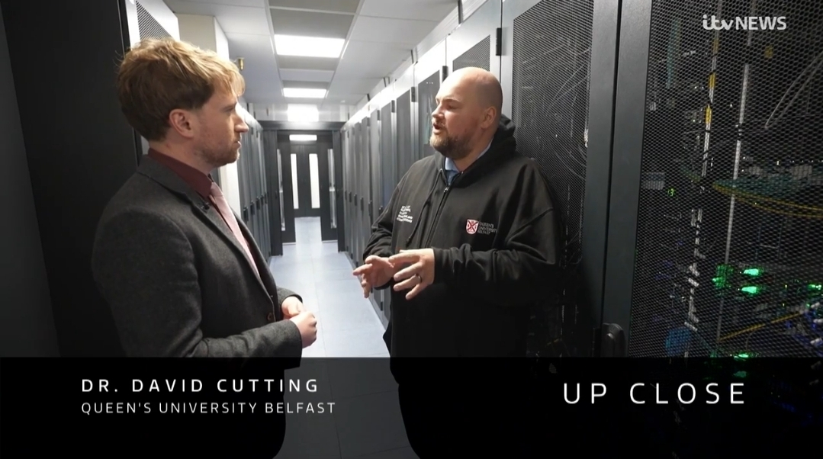

Slide 4
Specifications (probably)
From: https://ni-hpc.ac.uk/Kelvin2/
102 x 128 core Dell PowerEdge R6525 compute nodes with AMD EPYC 7702 dual 64-Core Processors (786GB RAM).
8 High memory nodes (2TB RAM).
32 x NVIDIA Tesla v100 GPUs in 8 nodes.
16 x NVIDIA Tesla A100 GPUs in 4 nodes.
4 x AMD MI300X GPU's in 1 node.
4 x Nvidia H100 GPUs in 1 node.
4 x Intel Max 1100 GPUs in 1 node.
2PB of lustre parallel file system for scratch storage.
All compute nodes and storage are connected by EDR Infiniband fabric.
Compute nodes run ROCKY8.10 operating system.

Slide 5
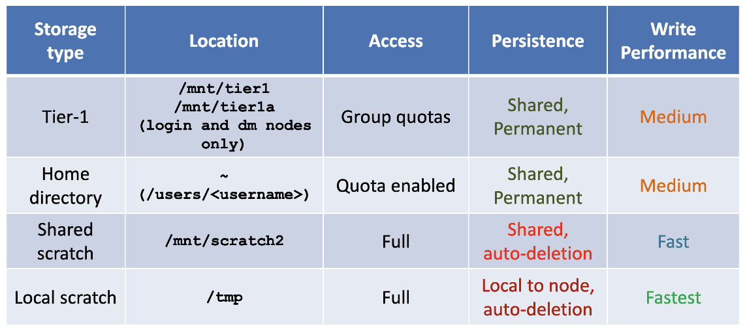
Storage
Source: NI-HPC

Slide 6
Jobs
Can be either be run interactively (srun) or in batch (sbatch)
Lots of options including resource requirements
Best-fit algorithm to schedule
Jobs are allocated to a partition depending on options given and assigned node(s) and resource(s)

Slide 7
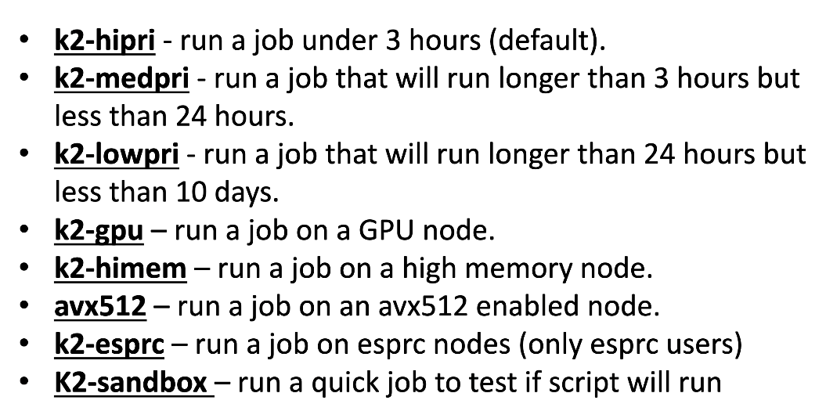
Kelvin 2 Partitions
Source: NI-HPC

Slide 8
Kelvin Demo

Slide 9

?
?
?
?
?
?
?
?
?
?
?

